Slide 1
The OWASP Enterprise Security API
Jeff Williams
OWASP Foundation Chair
jeff.williams@owasp.org
Aspect Security CEO
jeff.williams@aspectsecurity.com
Notes:
Hi – my name is Jeff Williams. I’m the CEO of Aspect Security, an application security consulting company, and I volunteer my time as the Chair of OWASP.

Slide 2
The Challenge…
Spring
Jasypt
Commons
Validator
Log4j
xml-enc
Cryptix
JAAS
JCE
Stinger
ACEGI
Struts
BouncyCastle
Reform
Anti-XSS
Many More
xml-dsig
HDIV
Java Logging

Slide 3
Philosophy
Using security controls is different from building
All the security guidelines, courses, tutorials, websites, books, etc… are all mixed up because everyone builds their own controls
Most developers shouldn’t build security controls
When to use a control
How to use a control
Why to use a control (maybe)
Most enterprises need the same set of calls

Slide 4
Design
Only include methods that…
Are widely useful and focus on the most risky areas
Designed to be simple to understand and use
Interfaces with concrete reference implementation
Full documentation and usage examples
Same basic API across common platforms
Java EE, .NET, PHP, others?
Useful to Rich Internet Applications?

Slide 5
Architecture Overview
Custom Enterprise Web Application
Authenticator
User
AccessController
AccessReferenceMap
Validator
Encoder
HTTPUtilities
Encryptor
EncryptedProperties
Randomizer
Logger
IntrusionDetector
Enterprise Security API
Exception Handling
SecurityConfiguration
Existing Enterprise Security Services/Libraries

Slide 6
Create Your ESAPI Implementation
Your Security Services
Wrap your existing libraries and services
Extend and customize your ESAPI implementation
Fill in gaps with the reference implementation
Your Coding Guideline
Tailor the ESAPI coding guidelines
Retrofit ESAPI patterns to existing code

Slide 7
Frameworks and ESAPI
ESAPI is NOT a framework
Just a collection of security functions, not “lock in”
Frameworks already have some security
Controls are frequently missing, incomplete, or wrong
ESAPI Framework Integration Project
We’ll share best practices for integrating
Hopefully, framework teams like Struts adopt ESAPI

Slide 8
Project Plan and Status
6/06 – Sketch Informal API
5/07 – Start Java EE Reference Implementation
7/07 - Form Expert Panel
7/09 – ESAPI 2.0 rc1
4/07 - Formalize Strawman API
9/07 – Sneak Peek
2002 – Start Collecting

Slide 9
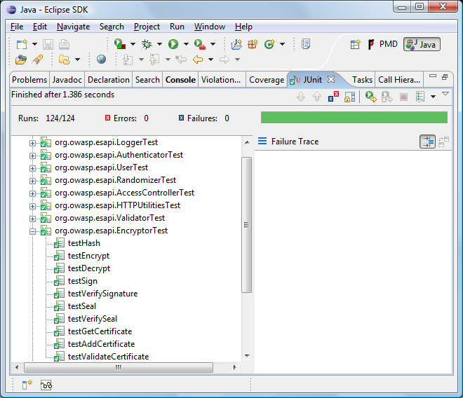

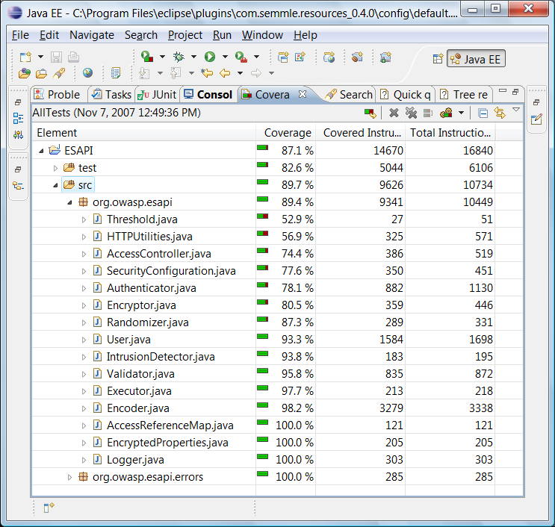


Quality

Slide 10
Handling Authentication and Identity
User
Controller
Business Functions
Data Layer
Backend
ESAPI
Authentication
Access Control
Logging
Intrusion Detection
Users

Slide 11
Authenticator
Key Methods
createUser(accountName, pass1, pass2)
generateStrongPassword()
getCurrentUser()
login(request, response)
logout()
verifyAccountNameStrength(acctName)
verifyPasswordStrength(newPass, oldPass)
Use threadlocal variable to store current User
Automatically change session on login and logout

Slide 12
User
Key Methods
changePassword(old, new1, new2)
disable() enable()
getAccountName() getScreenName()
getCSRFToken()
getLastFailedLoginTime() getLastLoginTime()
getRoles() isInRole(role)
isEnabled() isExpired() isLocked()
loginWithPassword(password, request, response)
resetCSRFToken() resetPassword()
verifyCSRFToken(token)

Slide 13
Enforcing Access Control
Controller
Business Functions
Data Layer
Web Service
URL Check
Function Check
Data Check
Service Check
Database
User
Mainframe
Etc…
User Interface
Function Check
File Check
File System

Slide 14
AccessController
Key Methods
isAuthorizedForData(key)
isAuthorizedForFile(filepath)
isAuthorizedForFunction(functionName)
isAuthorizedForService(serviceName)
isAuthorizedForURL(url)
Reference Implementation (not required)
/admin/* | admin | allow | admin access to /admin
/* | any | deny | default deny rule

Slide 15
Handling Direct Object References
Access Reference Map
Web Service
Indirect Reference
Direct
Reference
Database
User
Mainframe
File System
Report123.xls
Indirect Reference
Direct Reference
Etc…
http://app?file=7d3J93

Slide 16
AccessReferenceMap
Key Methods
getDirectReference(indirectReference)
getIndirectReference(directReference)
iterator()
update(directReferences)
Example
http://www.ibank.com?file=report123.xls
http://www.ibank.com?file=a3nr38

Slide 17
Validating and Encoding Untrusted Input
Web Service
Validate
EncodeForLDAP
Directory
User
Business Processing
Database
File System
EncodeForHTML
Validate
Etc…

Slide 18
Validator
Key Methods
isValidFileUpload(filepath, filename, content)
getValidDataFromBrowser(type, input)
isValidDataFromBrowser(type, input)
isValidHTTPRequest (request)
isValidRedirectLocation(location)
isValidSafeHTML(input), getValidSafeHTML(input)
safeReadLine(inputStream, maxchars)
Canonicalization is really important always ignored
Global validation of HTTP requests

Slide 19
<input name="test" value="test" onblur="&#x61ler&#116('xss field')">
%26lt;

Slide 20
Encoder
Key Methods
canonicalize(input), normalize(input)
encodeForBase64(input)
encodeForDN(input)
encodeForHTML(input)
encodeForHTMLAttribute(input)
…, encodeForJavascript, encodeForLDAP, encodeForSQL, encodeForURL, encodeForVBScript, encodeForXML, encodeForXMLAttribute, encodeForXPath

Slide 21
Enhancing HTTP
User
HTTP Utilities
Business Processing
Safe File Upload
Verify CSRF Token
Add Safe Header
No Cache Headers
Secure Redirect
Secure Cookies
Add CSRF Token
Safe Request Logging
Logging

Slide 22
HTTPUtilities
Key Methods
addCSRFToken(href), checkCSRFToken(href)
addSafeCookie(name, value, age, domain, path)
addSafeHeader(header, value)
changeSessionIdentifier()
getFileUploads(tempDir, finalDir)
isSecureChannel ()
killCookie(name)
sendSafeRedirect(href)
setContentType ()
setNoCacheHeaders()
Safer ways of dealing with HTTP, secure cookies

Slide 23
Encryptor
Key Methods
decrypt(ciphertext)
encrypt(plaintext)
hash(plaintext, salt)
loadCertificateFromFile(file)
getTimeStamp()
seal(data, expiration) verifySeal(seal, data)
sign(data) verifySignature(signature, data)
Simple master key in configuration
Minimal certificate support

Slide 24
EncryptedProperties
Key Methods
getProperty(key)
setProperty(key, value)
keySet()
load(inputStream)
store(outputStream, comments)
Simple protected storage for configuration data
Main program to preload encrypted data!

Slide 25
Randomizer
Key Methods
getRandomGUID()
getRandomInteger(min, max)
getRandomReal(min, max)
getRandomString(length, characterSet)
Several pre-defined character sets
Lowers, uppers, digits, specials, letters, alphanumerics, password, etc…

Slide 26
Exception Handling
EnterpriseSecurityException
AccessControlException(userMsg, logMsg)
AuthenticationException(userMsg, logMsg)
AvailabilityException(userMsg, logMsg)
CertificateException(userMsg, logMsg)
EncodingException(userMsg, logMsg)
EncryptionException(userMsg, logMsg)
ExecutorException(userMsg, logMsg)
IntrusionException(userMsg, logMsg)
ValidationException(userMsg, logMsg)
Sensible security exception framework

Slide 27
Logger
Key Methods
getLogger(moduleName)
getLogger(class)
logHTTPRequest (request, logger, sensitiveList)
logCritical(type, message, throwable)
logDebug(type, message, throwable)
logError(type, message, throwable)
logSuccess(type, message, throwable)
logTrace(type, message, throwable)
logWarning(type, message, throwable)
All EASPI exceptions are automatically logged

Slide 28
Detecting Intrusions
User
Business Processing
Backend
ESAPI
Events and Exceptions
Log, Logout, and Disable
IntrusionDetector
Tailorable
Quotas

Slide 29
IntrusionDetector
Key Methods
addException(exception)
addEvent(event)
Model
EnterpriseSecurityExceptions automatically added
Specify a threshold for each event type
org.owasp.esapi.ValidationException.count=3
org.owasp.esapi.ValidationException.interval=3 (seconds)
org.owasp.esapi.ValidationException.action=logout
Actions are log message, disable account

Slide 30
SecurityConfiguration
Customizable…
Crypto algorithms
Encoding algorithms
Character sets
Global validation rules
Logging preferences
Intrusion detection thresholds and actions
Etc…
All security-relevant configuration in one place

Slide 31
Coverage
A1. Cross Site Scripting (XSS)
A2. Injection Flaws
A3. Malicious File Execution
A4. Insecure Direct Object Reference
A5. Cross Site Request Forgery (CSRF)
A6. Leakage and Improper Error Handling
A7. Broken Authentication and Sessions
A8. Insecure Cryptographic Storage
A9. Insecure Communications
A10. Failure to Restrict URL Access
OWASP Top Ten
OWASP ESAPI
Validator, Encoder
Encoder
HTTPUtilities (upload)
AccessReferenceMap
User (csrftoken)
EnterpriseSecurityException, HTTPUtils
Authenticator, User, HTTPUtils
AccessController
Encryptor
HTTPUtilities (secure cookie, channel)

Slide 32
Closing Thoughts
I have learned an amazing amount (I thought I knew)
An ESAPI is a key part of a balanced breakfast
Build rqmts, guidelines, training, tools around your ESAPI
Secondary benefits
May help static analysis do better
Enables security upgrades across applications
Simplifies developer training
Next year – experiences moving to ESAPI

